Slide 1
Real Estate Management System

Slide 2
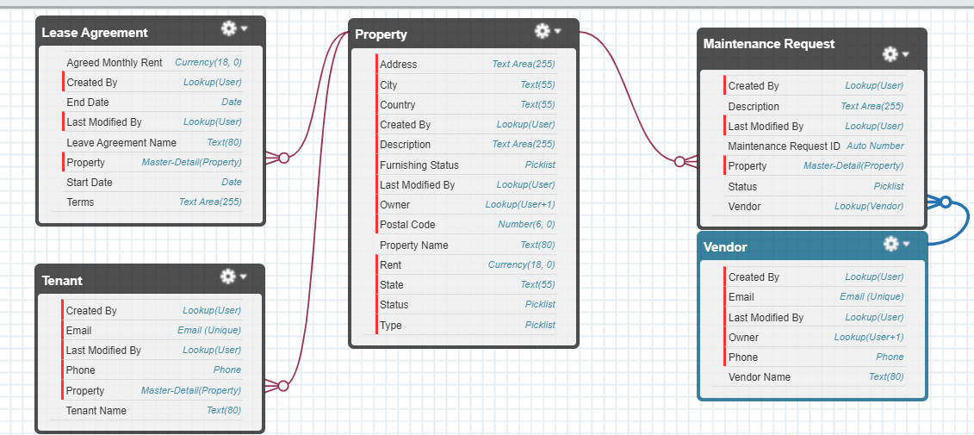
Objects

Slide 3
Relationship
Tenant and Property
Master Detail Relationship
Lease Agreement and Property
Master Detail Relationship
Maintenance Request and Property
Master Detail Relationship
Maintenance Request and Vendor
Lookup Relationship

Slide 4
Apex Trigger
CreateTaskOnPropertyAssignment
AssignMaintenanceRequestToVendor
SendLeaseExpiryEmail

Slide 5
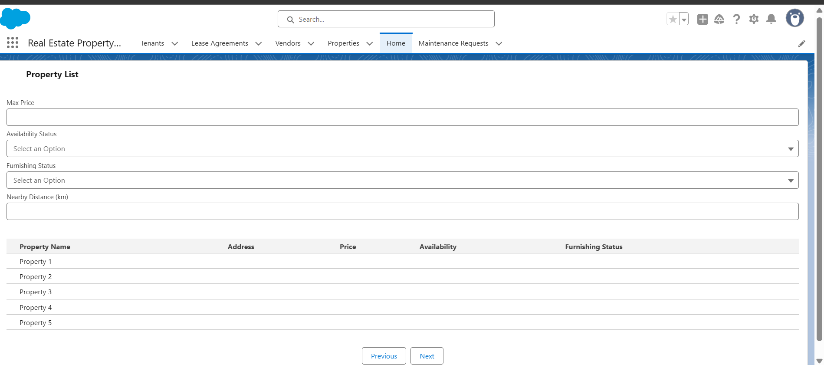
Lightning Web Component (LWC)
propertyList

Slide 6
Apex Class
PropertyController

Slide 7
Reports and Dashboard
Reports
Lease agreement expiring
Maintenance request status
Occupancy rate
Dashboard
Real Estate Overview

Slide 8
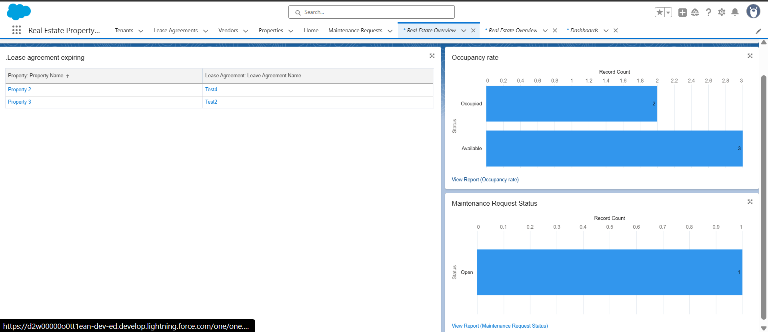

Slide 9
Thank you

